Slide 1

#OSG Corporate Community Boosters training
How #OSG method can help Corporate Community Boosters in their challenges
Alexandre QUACH, 2021

Slide 2
Course Outline
Since the digital age, (online) communities have flourished and shown the world how much link, content and opportunities it can generate.
In line with Digital, Agile and other cultural transformation, modern corporations also want to leverage the strength of this social way of working for their business and human development.
Among all the ways to build communities, the #OSG method is meant to develop knowledge sharing in organizations by providing mindset, tools, rules and tips in a consistent way and ready to use format.
The current course is meant to understand the underlying challenges that Corporate Community Boosters usually face no matter the method, before delving into #OSG methods concepts, basics and practice.

Slide 3





Part I : Understanding the Challenges before applying the Method
#OSG method is based on accumulated knowledge and real-life experiences of failures and successes in Community Boosting, in companies, public initiatives, non-profit organizations.
If one is to learn the #OSG method, one also must understand the undermining challenges it addresses. Otherwise, it would only be applying a formula in a context without any check on method-context fit. Such approach can be risky and even damaging to your Community.
If the challenges are well understood, #OSG Community Boosters are better prepared to use only relevant elements of the #OSG method, discard some others, upgrade or adapt some others, and even create new elements of methodology to enrich global knowledge about #OSG.
Always use the #OSG method relatively to existing situations, with a strong will to develop further understanding on your own Community, using #OSG or more.

Slide 4
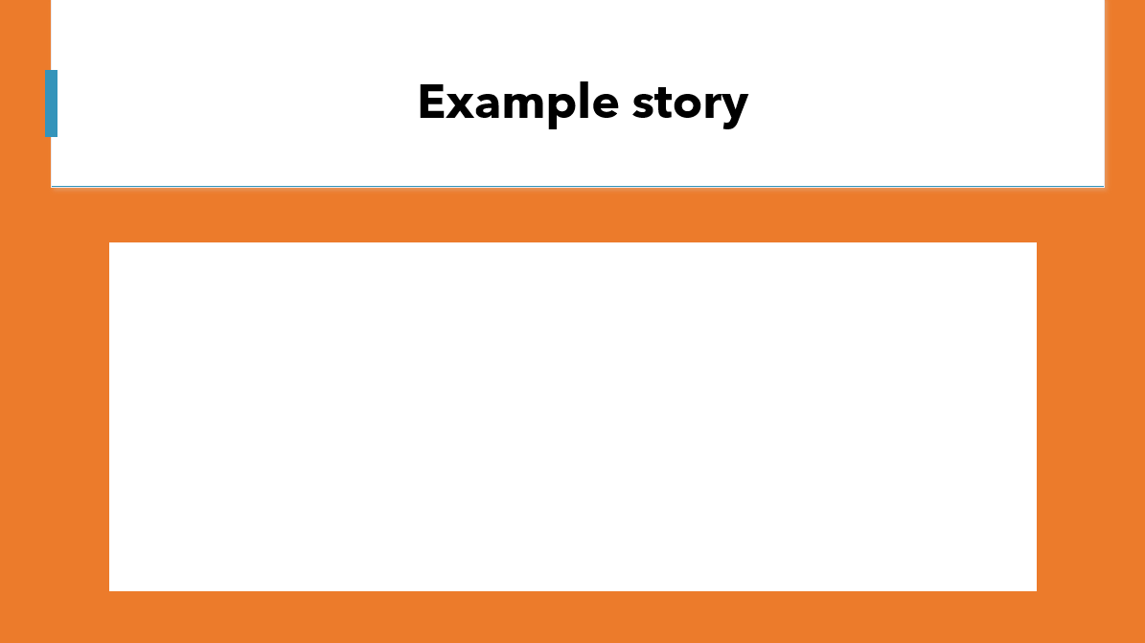
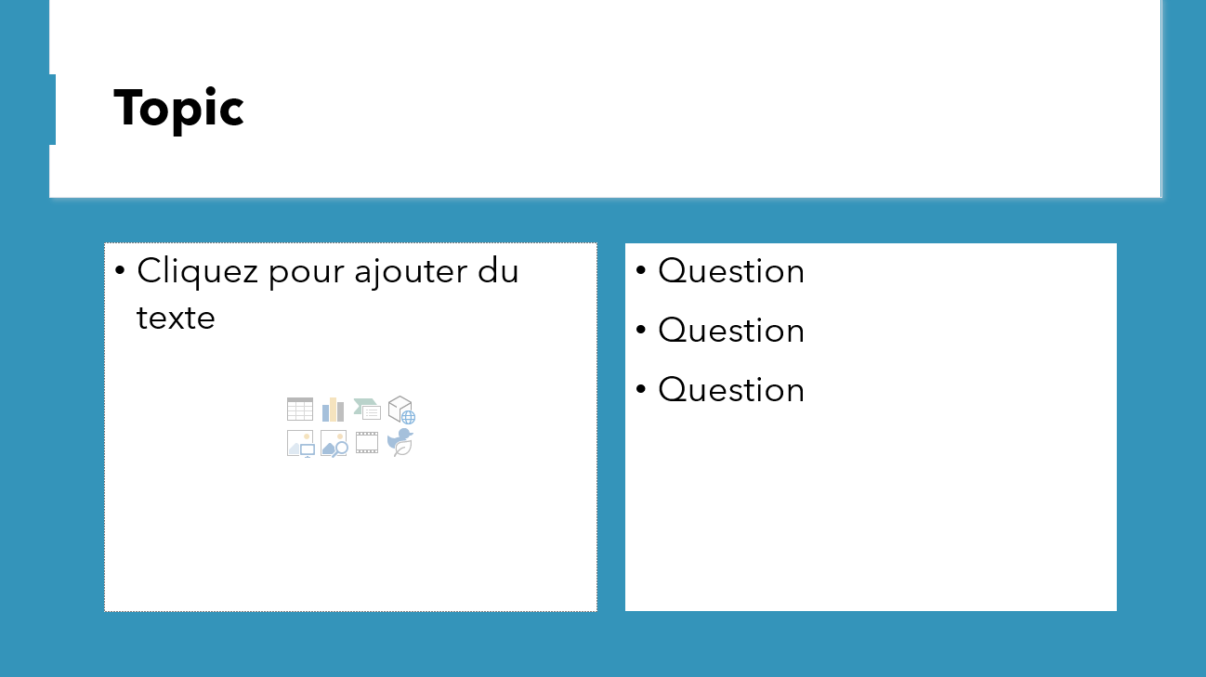
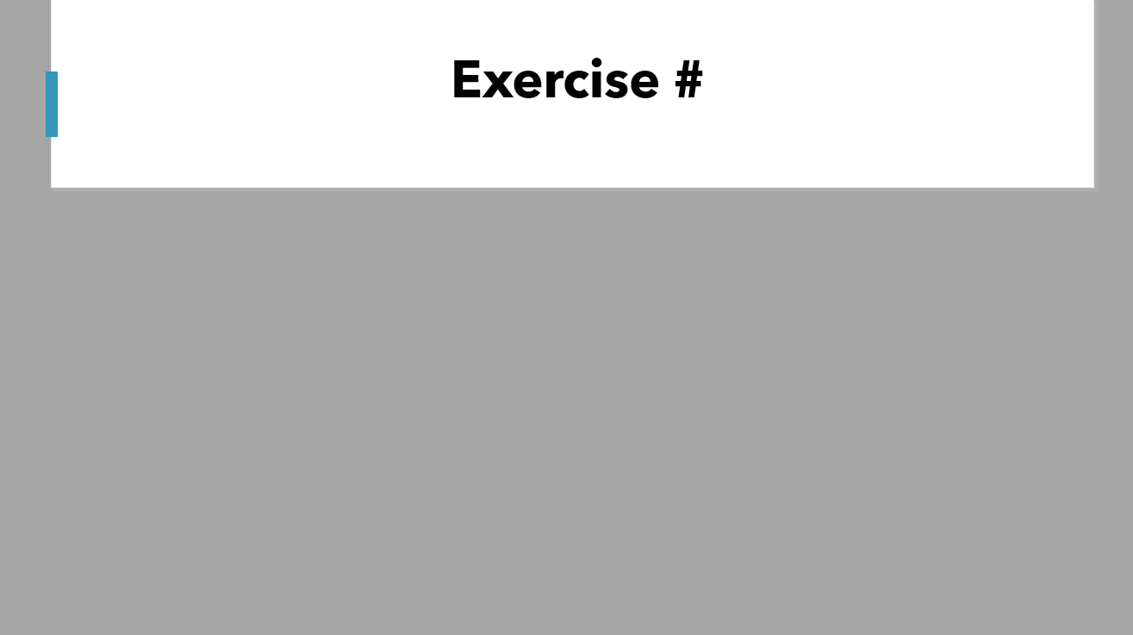
How to read and use this document
This document is tailored for training sessions for Corporate Community Boosters in small groups.
On top of course content (used further in #OSG method), and in order to anchor the knowledge deeper, this presentation also contains :
Example stories / use cases : Most elements in this course will refer to use cases and real-life stories turned into examples (made anonymous in this course).
Interaction moments : The more you interact about a given topic, the higher your chances to anchor the knowledge. You are invited to “stop and discuss” often, instead of just going through all the content in one-shot (which would give the impression to go fast, but can be unproductive on the long term)
Exercises allow you to apply your knowledge to your current corporate community

Slide 5

Part I : Corporate Community Boosters Challenges
Before learning a method, learn what challenges it addresses

Slide 6


Example story
I don’t know where to start,
there are so many topics !
Corporate Community Booster
Notes:
Answer :

Slide 7











Challenge #1 : 360° expectations
Top Management
You must nurture Unity, link, global vision. Therefore, you must integrate with all the job that has already been done and existing structures
Non-sponsoring Hierarchy
Sponsors
You must create transversal involvement in important topics, faster than the usual processes with key objectives.
You must convince managers that the people, members, resources are requested for a valuable reason, show projections and results. Every Quarter.
Value
Content
You must help a wide variety of initiatives to develop within, with and beyond the Community
You must provide interesting content and events for people who already receive lots of notifications and promotion
Non-active members (passive consumers)
Active members
Corporate Community Booster
You must learn to promote your Community without spamming, engaging without forcing, proposing without pressuring…
You must help new members onboard, understand what could be interesting for them, and teach how to get involved
Potential members
New members

Slide 8
Share your opinions and experiences
Do you agree with the list of stakeholders ?
Who are other stakeholders for a Corporate Community Booster ?
What other expectations do you regard as important ?
Top Management
Non-sponsoring Hierarchy
Sponsors
Value
Content
Non-active members (passive consumers)
Active members
Potential members
New members
Notes:
Answer :

Slide 9
Exercise #1 : Write down REAL expectations of your Current corporate Community Stakeholders & identities (real people) as example profiles
Top Management
Non-sponsoring Hierarchy
Sponsors
Value
Content
Non-active members (passive consumers)
Active members
Corporate Community Booster
Potential members
New members

